Slide 1
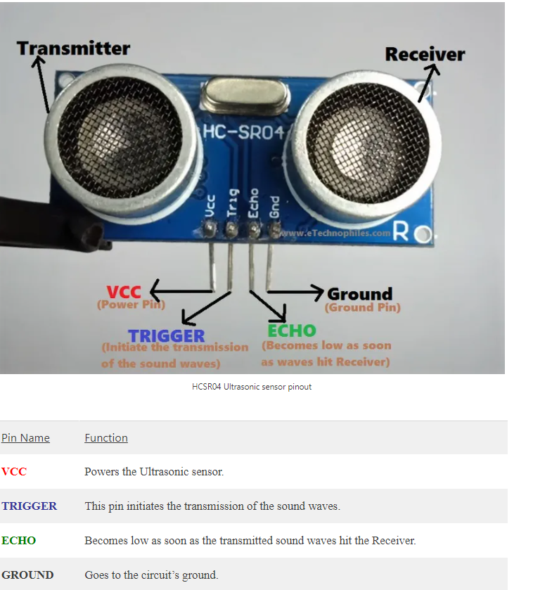
ULTRASONIC SENSOR HCSR04

Slide 2
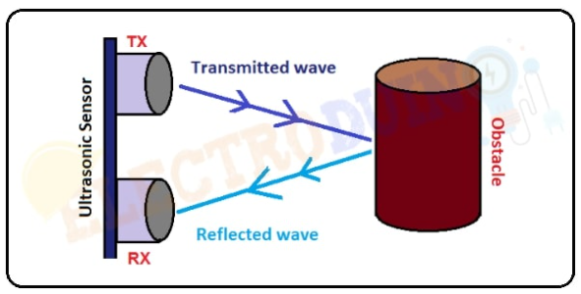
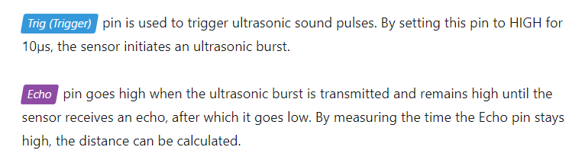
Distance to Obstacle = (Transmitted wave + Reflected wave) / 2

Slide 3
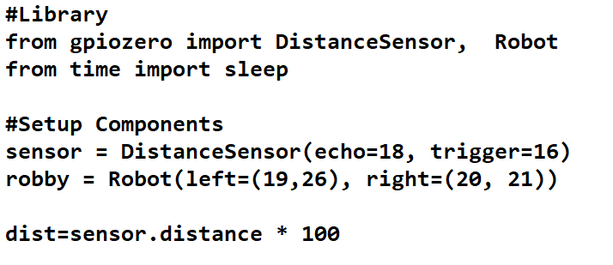
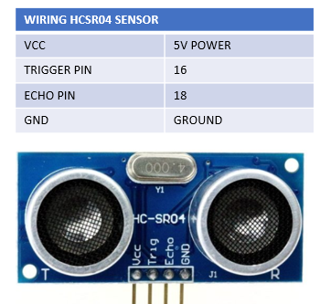
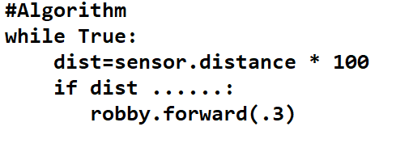

Slide 4
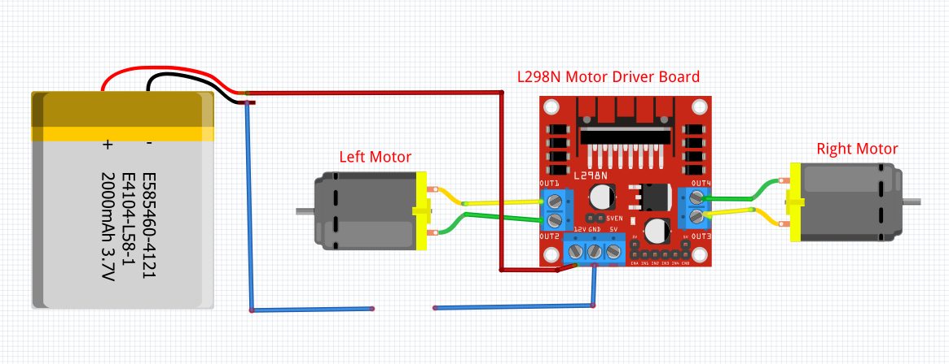
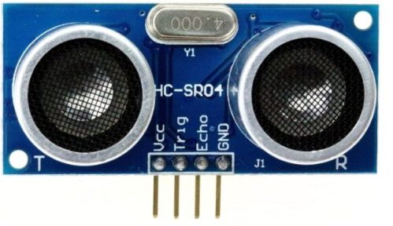
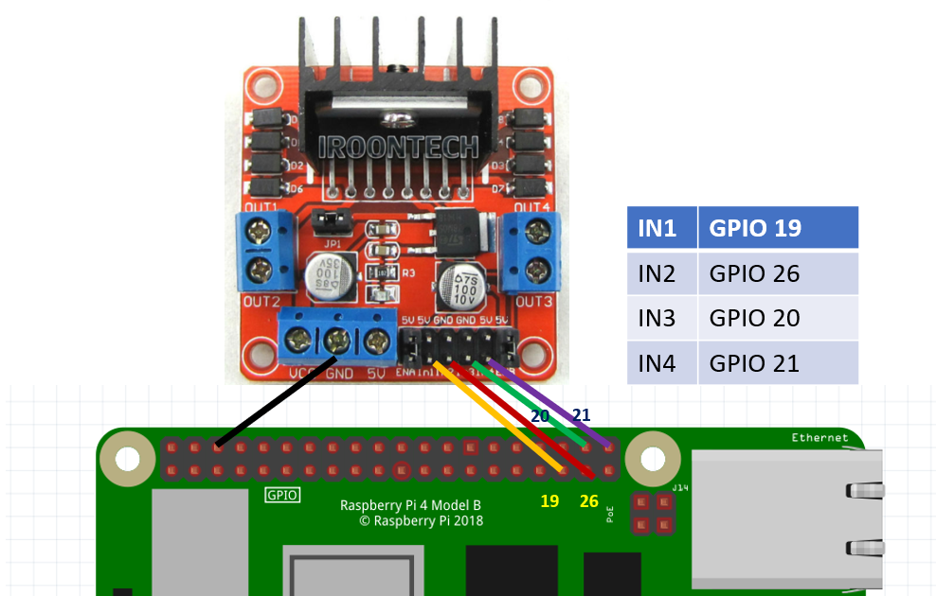
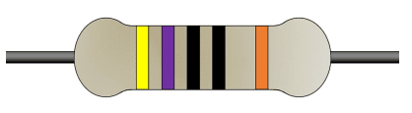
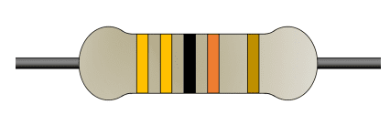
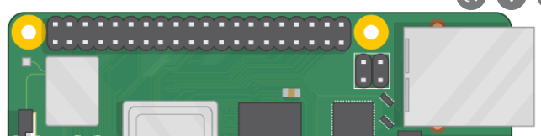
Wiring Diagram for Robot and Ultrasonic Sensor
WIRING HCSR04 SENSOR
VCC | 5V POWER
TRIGGER PIN | 16
ECHO PIN | 18
GND | GROUND
18
330 ohm
VCC
GND
16
470 ohm

Slide 5
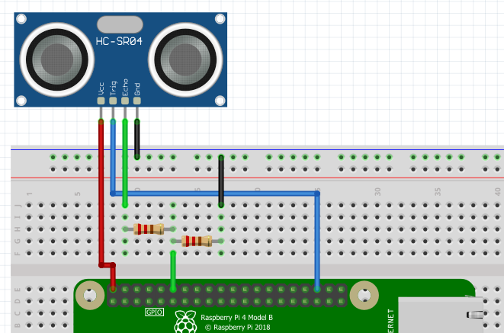
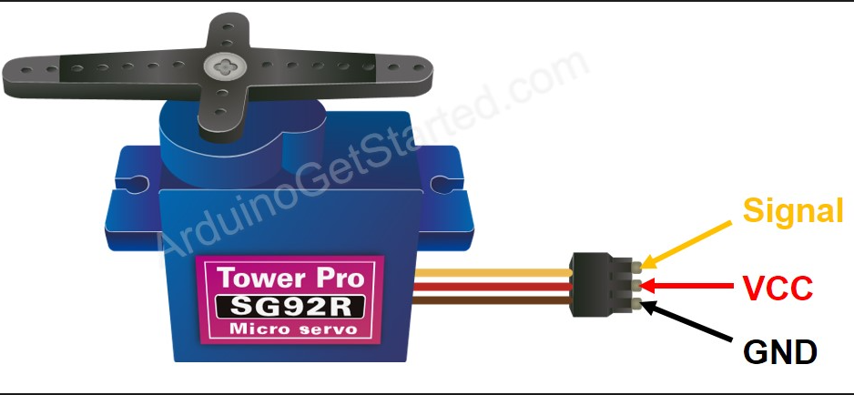
Wiring Diagram for Ultrasonic Sensor and Servo Motor
Voltage Divider
To convert 5v to 3v
330 ohm
470 ohm
5V
GND
GPIO 17
Pin 18
Pin 16
5V
https://gpiozero.readthedocs.io/en/stable/api_input.html?highlight=distancesensor#gpiozero.DistanceSensor
https://gpiozero.readthedocs.io/en/stable/api_input.html?highlight=distancesensor%5C#distancesensor-hc-sr04

Slide 6
SERVO MOTOR
GPIO 17
5V

Slide 7
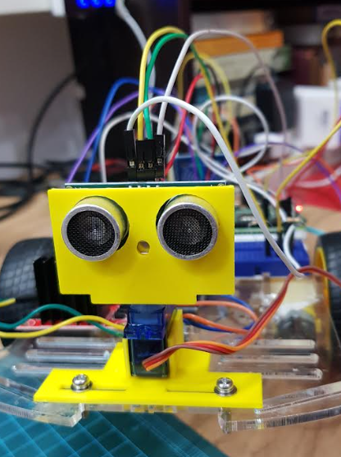
MOUNTING SERVO MOTOR AND ULTRASONIC SENSOR TO THE ROBOT

Slide 8
Factors determining performance of autonomous robot
Weight of Robot (Pi, Battery, Power Bank, Components)
Quality of Robot (friction on wheels affects direction)
Servo Motor Calibration
Type of battery driving H-Bridge
USB Rechargeable 9V 550mah recommended
- Assembly

